Slide 1
ALL CANADIAN PROGRAM RATES
February 2019
Notes:
1

Slide 2
OVERVIEW
In this session we will discuss
AC Program Performance in 2018
Current Market Considerations
The 2019 Rate Plan for the Program

Slide 3
CONTACTS AT CNS
Underwriting: programpacific_UW@cns.ca
retailpacific_UW@cns.ca
1-844-249-3541
UW Manager: Mike Wong
michael.wong@rsagroup.ca
778-372-6117
Sales Contact: Chantelle Zawila
chantelle.zawila@cns.ca
778-372-6267
Portal Contacts: Billy and Baldwin (billyhui@allcanadianins.com and baldwinma@allcanadianins.com)
AC Underwriting Conact: Heather Tang (heathertang@perpetualins.com)

Slide 4
2018 Performance

Slide 5
HIGH LEVEL RESULTS
2018 GWP: $20,176,608
2018 Losses: $13,582,026
2018 Loss Ratio: 69.7%
2018 Growth: 6.0%

Slide 6
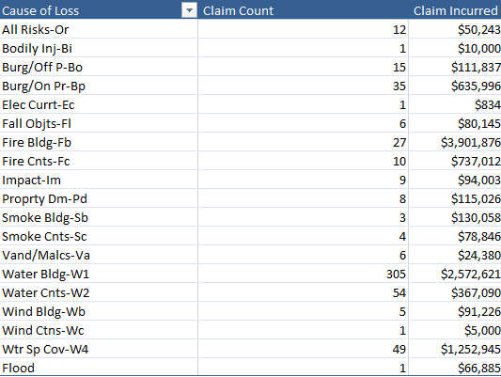
2018 LOSSES (ALL FORMS)

Slide 7
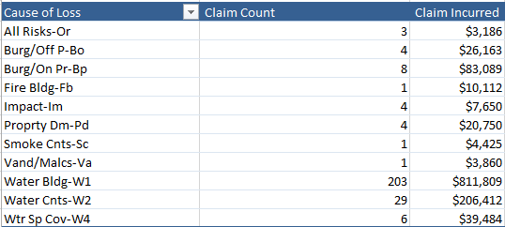
2018 LOSSES (CONDOS)

Slide 8
AREAS OF CONCERN
2017 Average Premium: $1,189
2018 Average Premium: $1,186
2018 Severity: $18,518 (highest since 2013)

Slide 9
Ways to Target Areas of Concern
Portfolio
Increase rates to build larger pool for increased severity
Once increased rates hit the books, look at metrics to take a more surgical approach to rates
Policy
Really try to stick to the guidelines set out in the All Canadian manual
Make sure that the right questions are being asked when applicants are seeking insurance

Slide 10
MARKET CONSIDERATIONS
Current Market
Market is hardening across the board
Most of our competitors had tough years last year
Industry is starting to recognize that increased losses are becoming a trend
We are seeing large rate increases throughout the market
CNS
Retail rates have sharply increased over the past year – now we are asking the programs to catch up
All programs are being asked to take similar rate increases

Slide 11
2019 AC Rate Plan

Slide 12
EFFECTIVE DATES FOR RATE CHANGES
All rate changes discussed over the next few slides will be effective the following dates:
March 1st New Business
May 1st Renewals

Slide 13
RATE AND INFLATION
Base Rate Increase
5% rate increase for all policies
This is in line with what we are asking of other programs and lower than what we have taken on retail
3% Inflation
This is in line with the government index

Slide 14
LOADINGS
Condo Unit Assessment: $75
Windstorm (Home/Rental): Increased $10
Interior Water – No Basement: $60
Interior Water – Basement: $120
Severity of Loss (Home/Rental): $20
Pre-1990 (Home/Rental): $30

Slide 15
OTHER CHANGES
$1,000 Deductible Discount: Decreased to 7%
$500 Deductible now surcharges 2%
Removed Highrise Discount Factor
Moving to CNS EQ and Water
Multi-Peril/Preferred Risk Discount
-Insured eligible for 15% when purchasing EQ

Slide 16
CAPPING
To ensure that these changes do not have a negative impact on retention, we will be capping renewal increases. Our experience on retail is that the capping amounts proposed have not negatively impacted retention, and we believe that it will be the same for the program
Homes/Rentals/Tenants (Base)
Claims Free; insured last 3+ years: 9%
Claims Free; Insured last 0-2 years: 11%
Claim in last 3 years: 18%
Claim in last year: 22% + loss of CFD
Condos
Claims Free; insured last 3+ years: Highest of 9% or $75
Claims Free; Insured last 0-2 years: Highest of 11% or $100
Claim in last 3 years: Highest of 18% or $120
Claim in last year: Highest of 22% or $150
EQ (All Forms)
High Risk Zones (s-v and 7-9): 45%
All Other Zones: 10%

Slide 17
EXPECTED RESULTS
Short Term
Build additional premium reserves in order to address increased severity
Long Term
Allow us time to determine a more surgical way to handle rates for the program going forward

Slide 18
MONITORING
In order to ensure that we do not negatively impact the program we will be closely monitoring the impact that these new rates are having. After 6 months of implementation we will review to see if any tweaks need to be made

Slide 19
Other ITEMS

Slide 20
OTHER ITEMS
Reminder that all AC program policy endorsements must be issued by the AC portal server – any offices currently not using the portal to issue AC declaration pages and endorsements are asked to going forward
For any questions on this or any specific changes to the portal please reach out to Billy or Baldwin

Slide 21
SUMMARY
2018 was a difficult year for the insurance industry; AC program was not immune
The current insurance market is hardening
We have a limited window to get rates onto the program book; all programs are taking similar rates
We will closely monitor outcomes and developments throughout the year

Slide 22
QUESTIONS?

